Slide 1

Credit Card Risk Prediction
Created by: Donovan Johnson and Kalide Endale

Slide 2
Inspiration for Project
We took on this project because we want to learn how to effectively underwrite risk and predict whether a candidate should or should not receive a credit card.
This project is important because models can directly affect the quality of life of those that interact with the algorithm. People use debt to finance investments, pay for school, or ease the pressure of day-to-day living. Credit cards play a pivotal role in the American financial system. An inadequate model can produce distorted predictions, which can harm the company's financial health and compromise the firm’s reputation

Slide 3
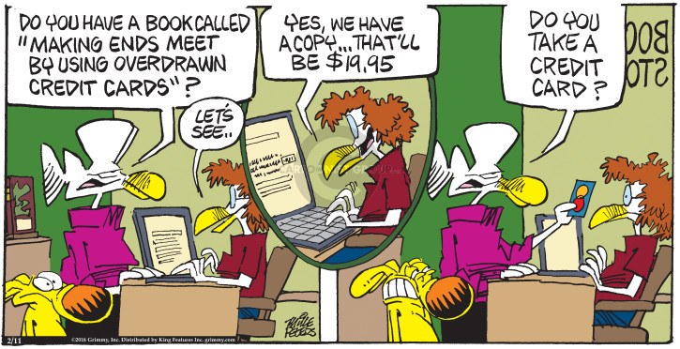
The Dataset
Credit Card Approval Risk (26)
dataset is split into two separate datasets: application record and credit record
26 total variables
4 continuous variables, e.g., Annual Income
1 ordinal, e.g., size of family
21 discrete variables, e.g., Number of children, owns a car, owns a property
438,557 data points in dataset
Goal: Determine important factors & build a classification model to predict whether a candidate should receive a credit card

Slide 4
Data Preparation
Created a binary dependent variable which was "1" if a candidate's status was 60 days past due, otherwise 0
Converted factor columns into dummy variables
Removed "NA" values from dataset
Joined datasets: "credit application" and "credit record"
Renamed features to improve readability of dataset
Conducted feature selection to reduce multi-collinearity
Partitioned data into training (80%) and testing (20%)
Feature standardization
Fixed the imbalance of credit risk in the training data using SMOTE
Final dataset had 430,134 rows

Slide 5
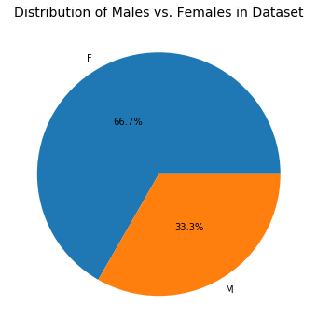
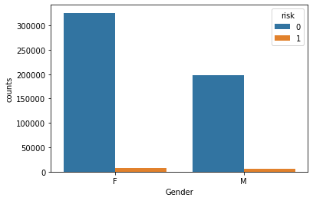
Exploratory Data Analysis
F (1): 8,067 M(1): 6,105
Figure 1: Percentage of Male vs. Female
Figure 2: Females vs. Males at risk (defaulted on payments)

Slide 6
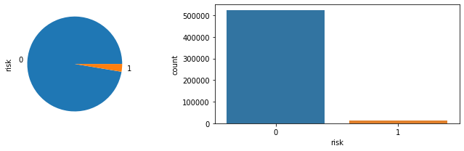
Exploratory Data Analysis (cont.)
Figure 3: Imbalance of non-defaults vs. Defaults(98.5% are 0's)

Slide 7
Fix Imbalance Using SMOTE
Oversampling: making duplicates of the data that is least present in the dataset
Data Augmentation: Advanced oversampling, instead of making exact duplicates, data augmentation creates synthetic data points by adding small perturbations to the original data points.
SMOTE algorithm takes sample of feature space for each target class and its neighbors and then generates new instances that combine the features of the target cases with features of its neighbors.
Shortcomings of SMOTE:
Overgeneralization: blindly generalizes the minority area without regard to the majority class
Lack of Flexibility: number of synthetic samples generated by SMOTE is fixed

Slide 8
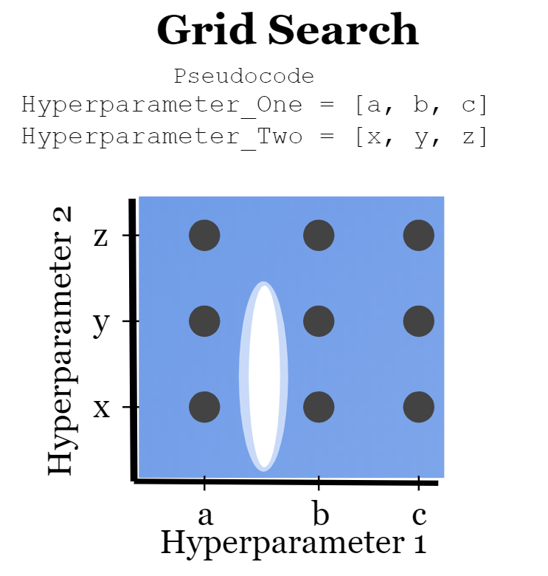
Hyper-parameter tuning: Grid Search CV
Grid Search CV:
runs through all the different parameters that is fed into the parameter grid and produces the best combination of parameters, based on a scoring metric of our choice (f1 score).

Slide 9
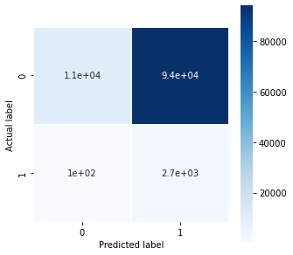
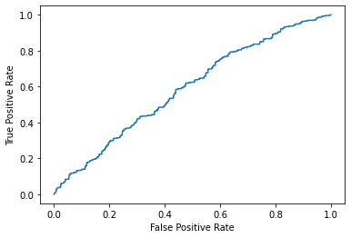
Naive Bayes
Accuracy: 0.1245
F1 Score: 0.0534
Hyper-Paramter Tuning:
Var_smoothing is a stability calculation to widen (or smooth) the curve and therefore account for more samples that are further away from the distribution mean.

Slide 10
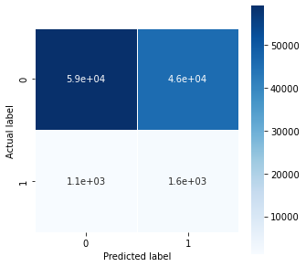
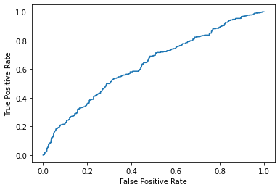
Logistic Regression
Accuracy: 0.5654
F1 score: 0.0652
Hyper-parameter Tuning: Penalty: Specify the norm of the penalty: 'l1', 'l2', 'elasticnet’.
C: Controls the penalty strength.
Solver: different solvers which try to find the parameter weights that minimize a cost function: 'newton-cg', 'lbfgs', 'liblinear'.

Slide 11
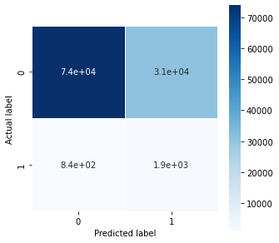
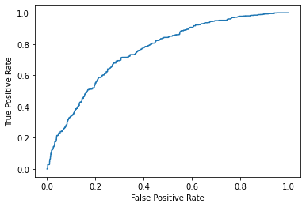
Adaboost
Accuracy: 0.7053
F1 score: 0.1078
Hyper-parameter Tuning:
Learning_rate: The rate at which we are adjusting the weights of our model with respect to the loss gradient.
n_estimators: The maximum number of estimators at which boosting is terminated. In case of perfect fit, the learning procedure is stopped early.

Slide 12
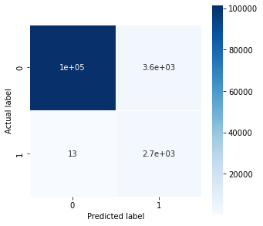
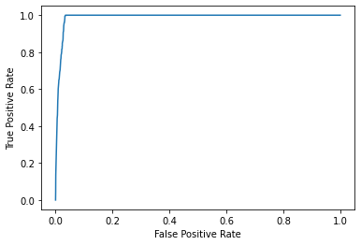
Random Forest
Accuracy: 0.9668
F1 score: 0.6057
Hyper-parameter Tuning:
Criterion: The function to measure the quality of a split. Supported criteria are “gini” for the Gini impurity and “entropy” for the information gain.
min_samples_split: The minimum number of samples required to split an internal node

Slide 13
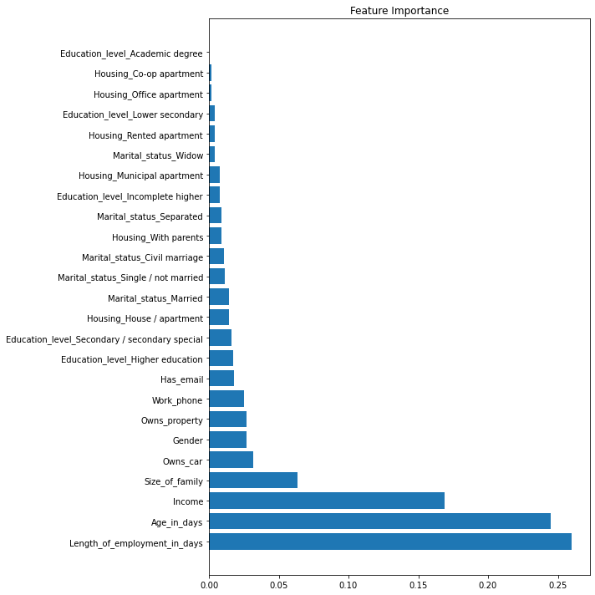
Final Model Conclusion
Most important features from our final model are Length of employment, Age, Income, and Size of family in that order.
After these four, there is a significant drop out in importance.

Slide 14
Discussion
Who could benefit:
Credit card companies can use or build off our models
Individual applicants: Understand the important indicators that to credit card companies
Limitations:
Models are computationally expensive especially when applying hyper-parameters
Other immeasurable factors not captured by dataset may have improved model
Limited knowledge working with unbalanced data. Other oversampling techniques could have been used.
Possible improvements:
Random forest regression tuning
Additional hyperparameter tuning
Run other non-linear classification models
More domain expertise
Could lead to development of stronger models
Unsupervised clustering models

Slide 15
Work Citation
Christopher, A. (2021, February 3). K-Nearest Neighbor. Medium. Retrieved March 16, 2022, from https://medium.com/swlh/k-nearest-neighbor-ca2593d7a3c4
GreatLearningTeam. “Hyperparameter Tuning with GRIDSEARCHCV.” GreatLearning Blog: Free Resources What Matters to Shape Your Career!, 20 Sept. 2020, https://www.mygreatlearning.com/blog/gridsearchcv/.
IBISWorld. (2021, July 31). Industry market research, reports, and Statistics. IBISWorld. Retrieved March 15, 2022, from https://www.ibisworld.com/industry-statistics/market-size/credit-card-issuing-united-states/
Korstanje, Joos. “Smote.” Medium, Towards Data Science, 30 Aug. 2021, https://towardsdatascience.com/smote-fdce2f605729.
J. Kong, W. Kowalczyk, D. A. Nguyen, T. Bäck and S. Menzel, "Hyperparameter Optimisation for Improving Classification under Class Imbalance," 2019 IEEE Symposium Series on Computational Intelligence (SSCI), 2019, pp. 3072-3078, doi: 10.1109/SSCI44817.2019.9002679
KNN(K-Nearest Neighbour) algorithm, maths behind it and how to find the best value for K. (2019, October 25). Medium. Retrieved March 16, 2022, from https://medium.com/@rdhawan201455/knn-k-nearest-neighbour-algorithm-maths-behind-it-and-how-to-find-the-best-value-for-k-6ff5b0955e3d
Molnar, C. (2022, March 4). Interpretable machine learning. 5.2 Logistic Regression. Retrieved March 16, 2022, from https://christophm.github.io/interpretable-ml-book/logistic.html
Rai, K. (2020, June 14). The math behind Logistic Regression | by Khushwant Rai | Analytics Vidhya. Medium. Retrieved March 16, 2022, from https://medium.com/analytics-vidhya/the-math-behind-logistic-regression-c2f04ca27bca
Seanny. (2020). Credit card approval prediction. Kaggle. Retrieved March 15, 2022, from https://www.kaggle.com/rikdifos/credit-card-approval-prediction
Yiu, T. (2019, June 12). Understanding Random Forest. How the Algorithm Works and Why it Is… | by Tony Yiu. Towards Data Science. Retrieved March 16, 2022, from https://towardsdatascience.com/understanding-random-forest-58381e0602d2

Slide 16
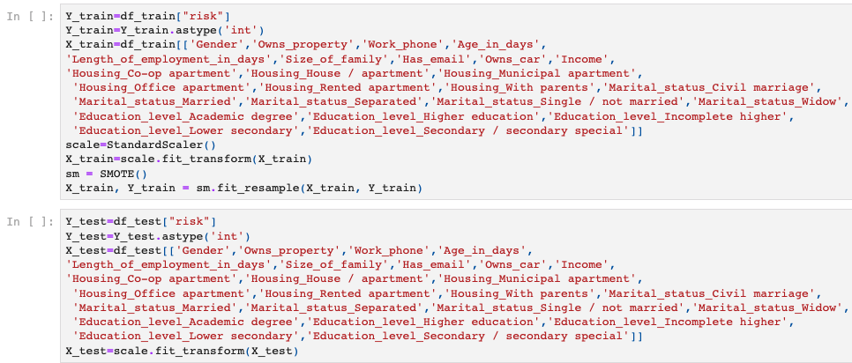
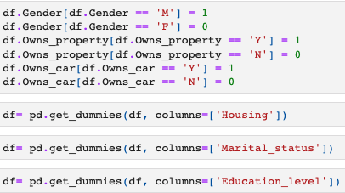
Appendix
Performing SMOTE to fix Imbalanced data:
Convert Features to Binary:

Slide 17

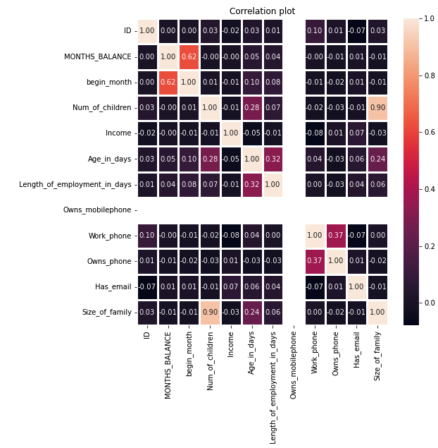
Appendix cont.
Correlation plot amongst features is largely uncorrelated apart from "size of family" and “number of children”

Slide 18
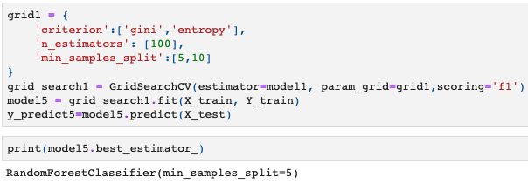
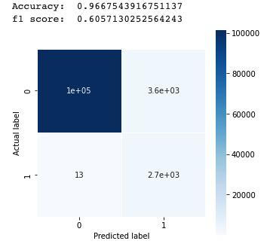
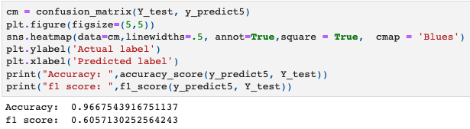
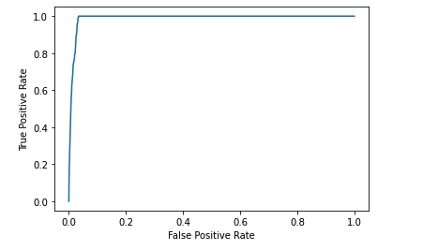
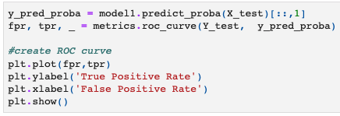
Appendix cont.
Random Forest Model:
Random Forest Test Model Confusion Matrix:
ROC of Random Forest:

